Slide 1
Front End Engineering-I Project
Team Details:
1. ARYAN BANSAL (2310990303)
2. ARYAN DHIMAN (2310990302)
Faculty Coordinator: Dr. Niharika Thakur
Chitkara University Institute of Engineering and Technology,
Chitkara University, Punjab

Slide 2
Table of Contents
Introduction
Problem Statement
Technical Details
Key Features
Project Highlights
Bonus Feature
Conclusion
References/Links used

Slide 3
Introduction
TITLE: BUILD YOUR OWN PORTFOLIO SITE
TEAM: 1. Aryan Bansal (2310990303)
2. Aryan Dhiman (2310990302)
OVERVIEW: This project aims to create a fully responsive portfolio for the job.

Slide 4
Problem Statement
Problem: A student of Chitkara University is applying for a job, he wants to make a portfolio website for all his learnings and achievements. For this he is using HTML, CSS & JS and created an aesthetic website to achieve his dream job.

Slide 5
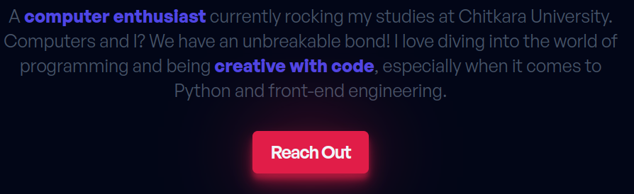
Technical Details
In this project, I have utilized a wide range of HTML tags and attributes, alongside CSS, to enhance the overall functionality and aesthetics.
I have also added a touch of JavaScript.
I have included media queries in a way that the page looks charming in all screen sizes.
The colors I have used are from Tailwind CSS docs, and are pleasing to the eyes.

Slide 6
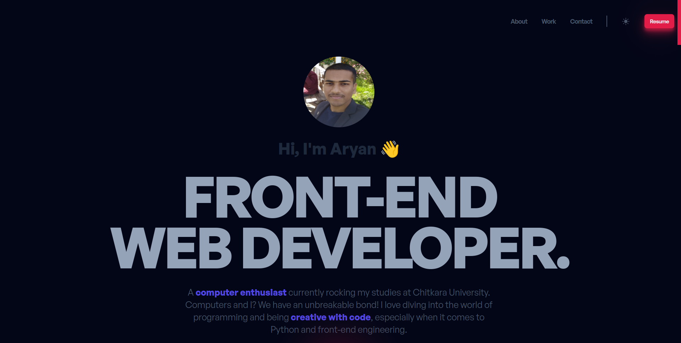
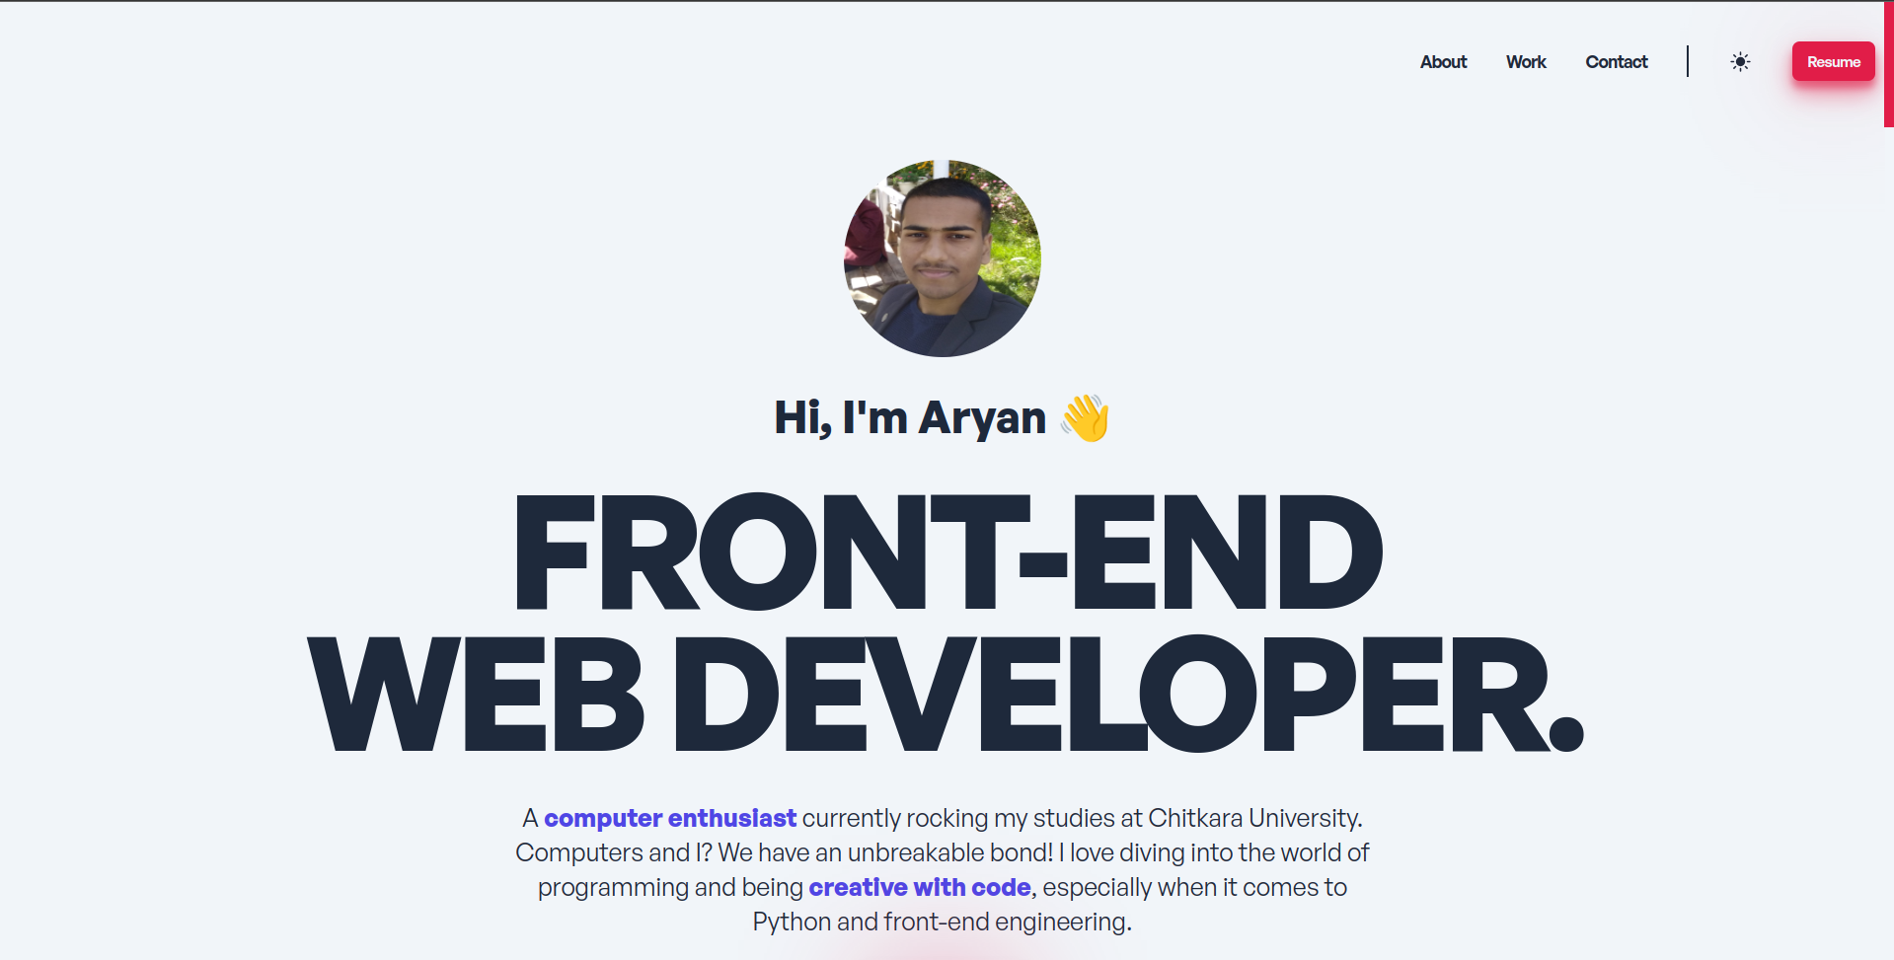
Key Features
I have made this using Vite framework, making it easy to build and run the developer view.
All the necessary sections required in a portfolio are added.
Having both dark and light mode for people with preference.

Slide 7

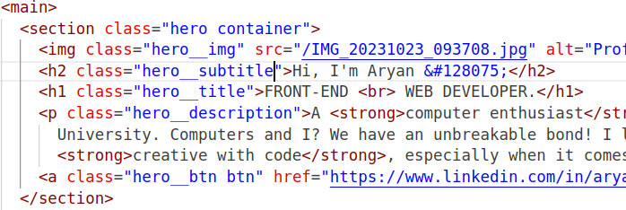
Project Highlights
The home page have a header with all necessary button and then a quick introduction to my quick details.
I have highlighted things in different colors.

Slide 8
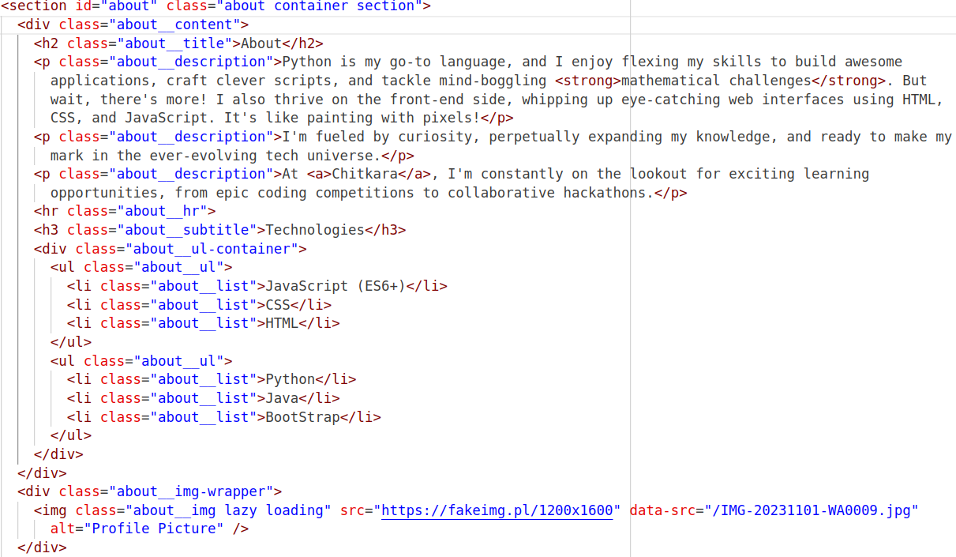
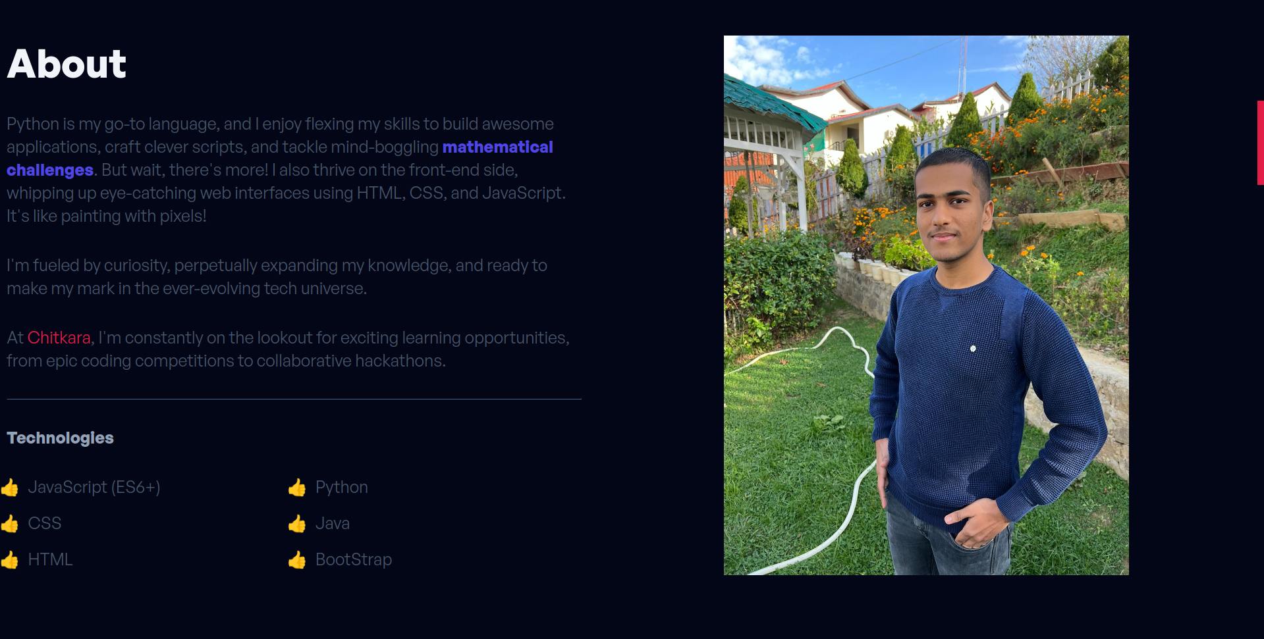
Project Highlights
Then comes the about page with shows my detailed biography and the technologies I use in my work.

Slide 9
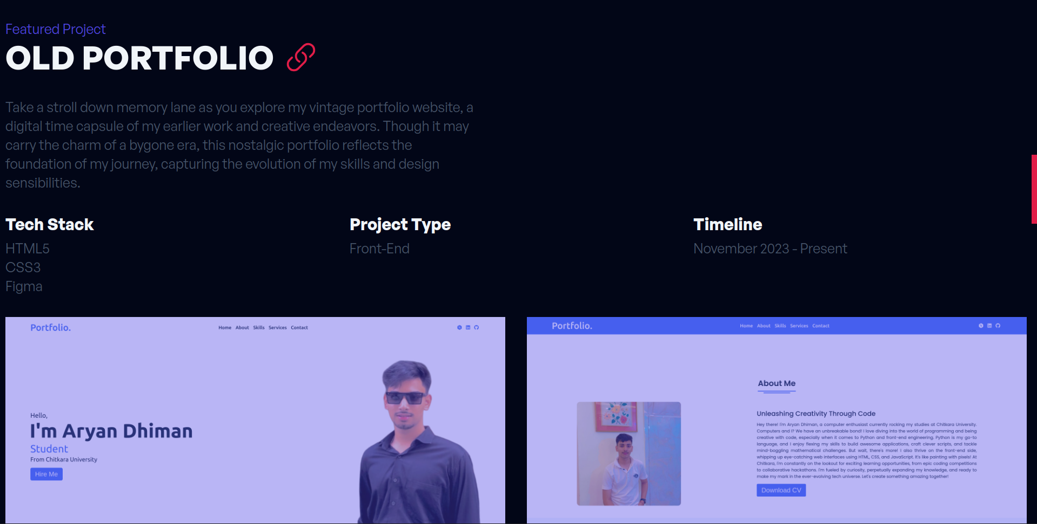
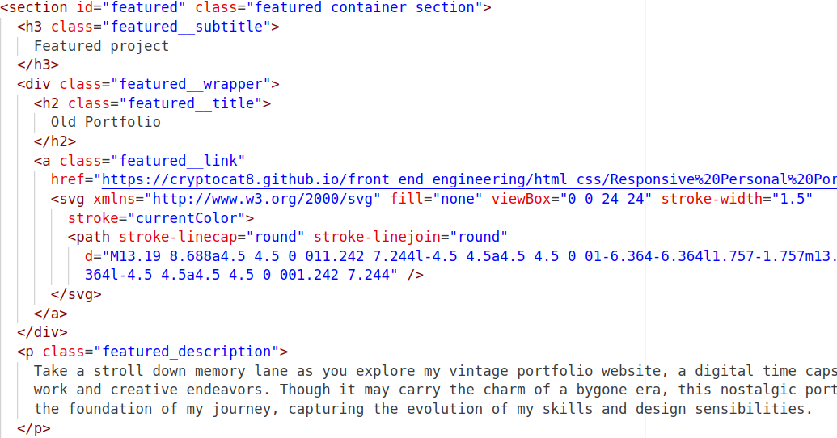
Project Highlights
When you scroll further, you will find my featured project, which have a cool link icon next to it. I have also displayed the Tech Stack used in it.

Slide 10
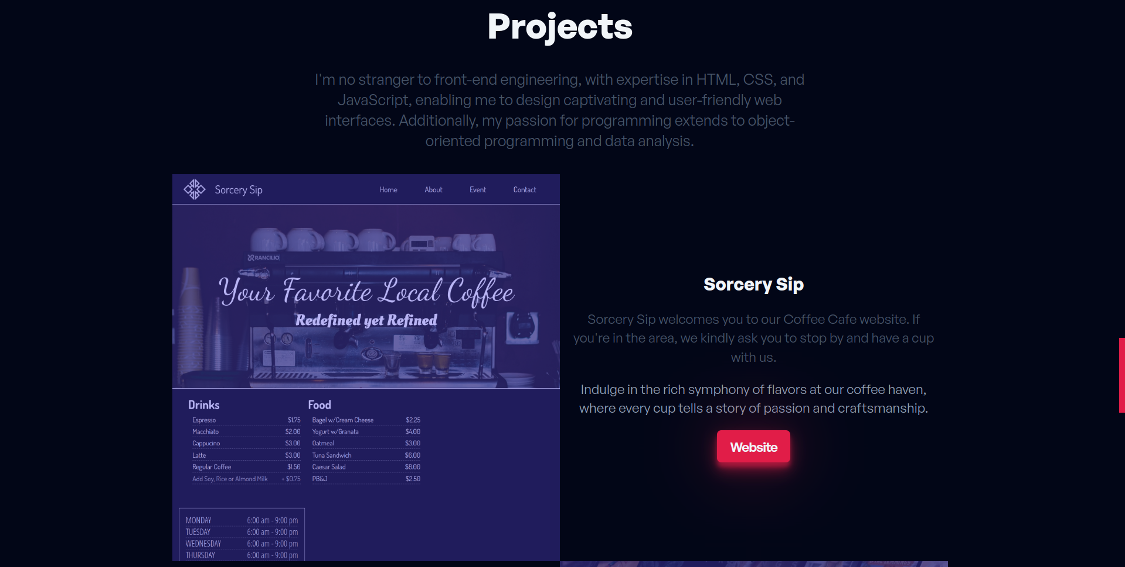
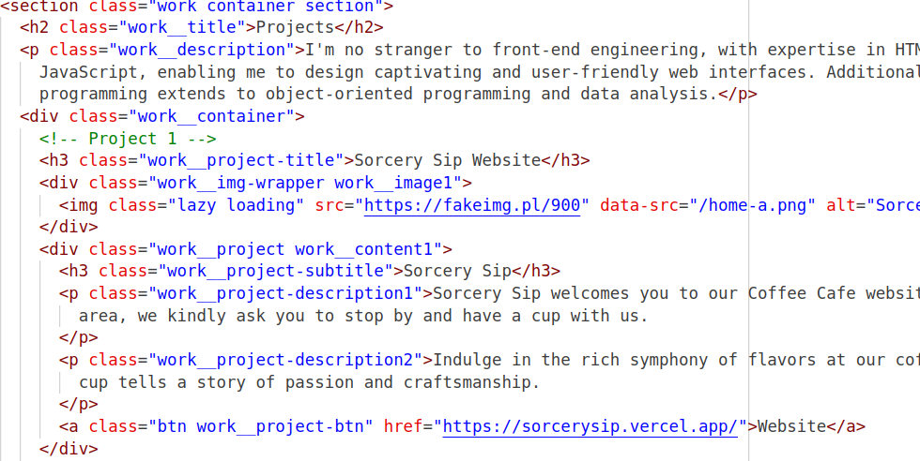
Project Highlights
Next is the projects corner which displays all my projects with their description and a link that takes you to their website. I have also used hover effects.

Slide 11
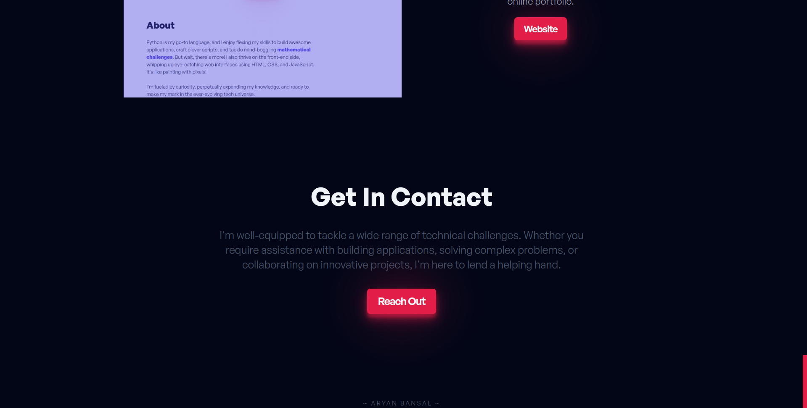
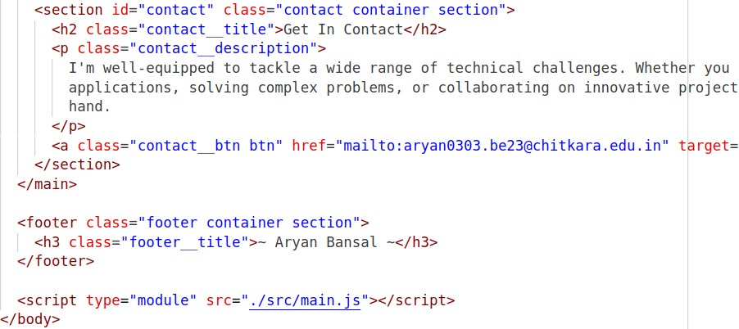
Project Highlights
The last section is the Contact Me section which have my email linked to the button, making it easy for any recruiter to contact. And my name at the bottom.

Slide 12
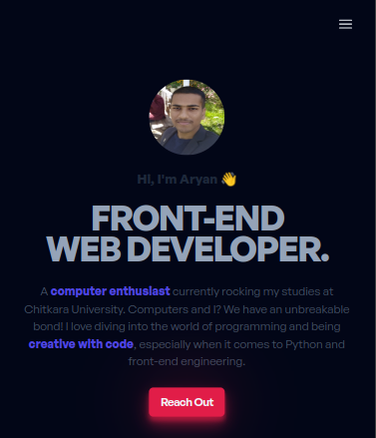
Bonus Feature
The website I have made is super responsive, we have taken consideration of all screen sizes and included hamburger icon using JS, for mobile screens.

Slide 13
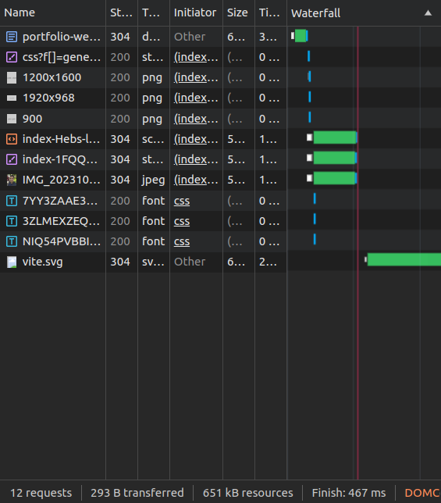
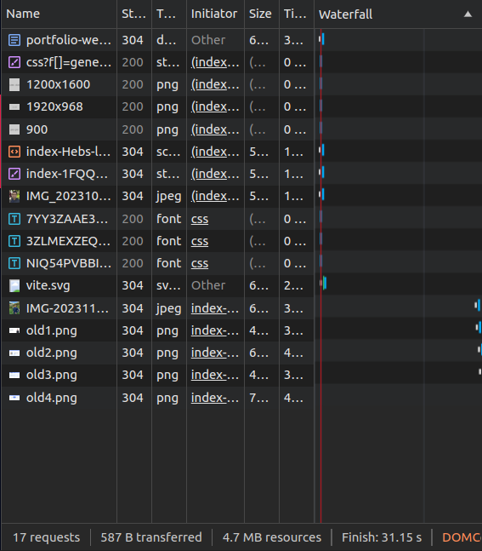

Bonus Feature
I have included a lazy loading that will load images only when the screen scrolls to them, improving website efficiency and also affects SEO.

Slide 14
Conclusion
We took this project as a challenge and made everything through hit and try, we used online resources for needed tags, which enhanced our problem solving skills. The project will also help us in our real placement as this format can be used for our own real portfolio.
It also enhanced our understanding of how to efficiently work as a team and create beautiful designs.

Slide 15
References/Links used
https://css-tricks.com/
https://tailwindcss.com/docs/customizing-colors
https://api.fontshare.com/v2/css?f[]=general-sans@500,600,400,700&display=swap
https://www.w3.org/2000/svg
https://fakeimg.pl/1200x1600

Slide 16


